Slide 1
ECE408 Spring 2018 Applied Parallel Programming Lecture 22: Parallel Sparse Methods

Slide 2
Objective
To learn to regularize irregular data with
Limiting variations with clamping
Sorting
Transposition
To learn to write a high-performance SpMV kernel based on JDS transposed format

Slide 3
Coordinate (COO) format
Explicitly list the column and row indices for every non-zero element
 |  |  | Row 0 |  |  | Row 2 |  |  |  | Row 3
Nonzero values | data[7] | { | 3, | 1, |  | 2, | 4, | 1, |  | 1, | 1 | }
Column indices | col_index[7] | { | 0, | 2, |  | 1, | 2, | 3, |  | 0, | 3 | }
Row indices | row_index[7] | { | 0, | 0, |  | 2, | 2, | 2, |  | 3, | 3 | }

Slide 4
COO Allows Reordering of Elements
 |  |  | Row 0 |  |  | Row 2 |  |  |  | Row 3
Nonzero values | data[7] | { | 3, | 1, |  | 2, | 4, | 1, |  | 1, | 1 | }
Column indices | col_index[7] | { | 0, | 2, |  | 1, | 2, | 3, |  | 0, | 3 | }
Row indices | row_index[7] | { | 0, | 0, |  | 2, | 2, | 2, |  | 3, | 3 | }
Nonzero values | data[7] | { | 1 | 1, | 2, | 4, | 3, | 1 | 1 | }
Column indices | col_index[7] | { | 0 | 2, | 1, | 2, | 0, | 3, | 3 | }
Row indices | row_index[7] | { | 3 | 0, | 2, | 2, | 0, | 2, | 3 | }

Slide 5
1. for (int i = 0; i < num_elem; row++)
2. y[row_index[i]] += data[i] * x[col_index[i]];
a sequential loop that implements SpMV/COO

Slide 6
COO Kernel Design Accessing Input Matrix and Vector
x
v
Ax = v
All threads can access matrix data and the accessed col_index to access vector
Maximal parallelism..
Row
Col
Data
A
COO Storage Format

Slide 7
COO kernel Design Accumulating into Output Vector
x
v
Ax = v
Each threads uses the row_index of its element to accumulate into one of the output Y elements
Need atomic operations!
Row
Col
Data
A

Slide 8
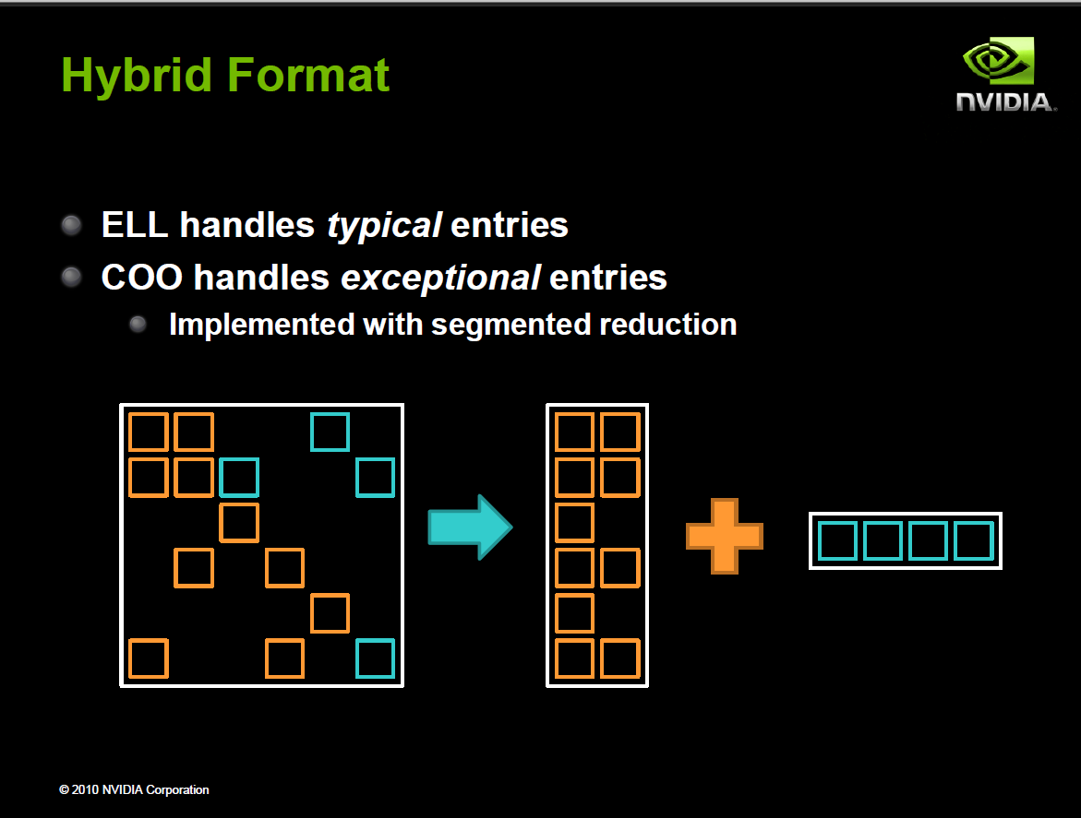
Often implemented in sequential host code in practice

Slide 9
Reduced Padding with Hybrid Format
 |  | data |  |  | col_index
Thread 0 |  | 3 | 1 |  | 0 | 2
Thread 1 |  | * | * |  | * | *
Thread 2 |  | 2 | 4 |  | 1 | 2
Thread 3 |  | 1 | 1 |  | 0 | 3
Thread 0
Thread 1
Thread 2
Thread 3
Iteration 0
data
3
*
2
1
1
*
4
1
data
1
col_index
3
index
0
*
1
0
2
*
2
3
row_index
2
ELL
COO

Slide 10
JDS (Jagged Diagonal Sparse) Kernel Design for Load Balancing
Perm with
matRowPerm
Access with
col_index
Sort rows into descending order according to number of non-zero. Keep track of the original row numbers so that the output vector can be generated correctly.
JDS Format

Slide 11
Sorting Rows According to Length (Regularization)
3
1
2
4
1
Row 2
3
1
Row 0
2
4
1
1
1
Row 3
1
1
Row 1
CSR
JDS

Slide 12
CSR to JDS Conversion
 |  |  | Row 0 |  |  | Row 2 |  |  |  | Row 3
Nonzero values | data[7] | { | 3, | 1, |  | 2, | 4, | 1, |  | 1, | 1 | }
Column indices | col_index[7] | { | 0, | 2, |  | 1, | 2, | 3, |  | 0, | 3 | }
Row Pointers | row_ptr[5] | { | 0, 2, 2, 5, 7 }
 |  |  | Row 2 |  | Row 0 |  |  |  |  | Row 3
Nonzero values | data[7] | { | 2, | 4, | 1, |  | 3, | 1, |  | 1 | 1 | }
Column indices | col_index[7] | { | 1, | 2, | 3, |  | 0, | 2, |  | 0, | 3 | }
JDS Row Pointers | jds_row_ptr[5] | { | 0, 3, 5, 7,7 }
JDS Row Indices | jds_row_perm[4] | { | 2, 0, 3, 1 }

Slide 13
JDS Summary
Nonzero values | data[7] | { 2, 4, 1, 3, 1, 1, 1 }
Column indices | Jds_col_index[7] | { 1, 2, 3, 0, 2, 0, 3 }
JDS row indices | Jds_row_perm[4] | { 2, 0, 3, 1 }
JDS Row Ptrs | Jds_row_ptr[5] | { 0, 3, 5, 7, 7 }
2
4
1
3
1
1
1
1
2
3
0
0
2
3

Slide 14
A Parallel SpMV/JDS Kernel
__global__ void SpMV_JDS(int num_rows, float *data,
int *col_index, int *jds_row_ptr,int *jds_row_perm,
float *x, float *y) {
2. int row = blockIdx.x * blockDim.x + threadIdx.x;
3. if (row < num_rows) {
4. float dot = 0;
5. int row_start = jds_row_ptr[row];
6. int row_end = jds_row_ptr[row+1];
7. for (int elem = row_start; elem < row_end; elem++) {
8. dot += data[elem] * x[col_index[elem]];
}
9. y[jds_row_perm[row]] = dot;
}
}
 |  |  | Row 2 |  | Row 0 |  |  |  |  | Row 3
Nonzero values | data[7] | { | 2, | 4, | 1, |  | 3, | 1, |  | 1 | 1 | }
Column indices | col_index[7] | { | 1, | 2, | 3, |  | 0, | 2, |  | 0, | 3 | }
JDS Row Pointers | jds_row_ptr[5] | { | 0, 3, 5, 7,7 }
JDS Row Indices | jds_row_perm[4] | { | 2, 0, 3, 1 }

Slide 15
JDS vs. CSR - Control Divergence
Threads still execute different number of iterations in the JDS kernel for-loop
However, neighboring threads tend to execute similar number of iterations because of sorting.
Better thread utilization, less control divergence
Nonzero values | data[7] | { 2, 4, 1, 3, 1, 1, 1 }
Column indices | col_index[7] | { 1, 2, 3, 0, 2, 0, 3 }
JDS row indices | Jds_row_perm[4] | { 2, 0, 3, 1 }
JDS Row Ptrs | Jds_row_ptr[5] | { 0, 3, 5, 7, 7 }
data
2
4
1
3
1
1
1
col_index
1
2
3
0
2
0
3

Slide 16
JDS vs. CSR Memory Divergence
Adjacent threads still access non-adjacent memory locations
Nonzero values | data[7] | { 2, 4, 1, 3, 1, 1, 1 }
Column indices | col_index[7] | { 1, 2, 3, 0, 2, 0, 3 }
JDS row indices | jds_row_perm[4] | { 2, 0, 3, 1 }
JDS Row Ptrs | jds_row_ptr[5] | { 0, 3, 5, 7, 7 }
data
2
4
1
3
1
1
1
col_index
1
2
3
0
2
0
3

Slide 17
JDS with Trasposition
jds_col_ptr
Access with col_index
Perm with jds_row_index

Slide 18
Transposition for Memory Coalescing
2
4
1
2
3
1
Row 2
3
1
4
1
1
Row 0
1
1
1
Row 3
Row 1
JDS
JDS-transposed

Slide 19
JDS Format with Transposed Layout
Row 0 | 3 | 0 | 1 | 0 | Thread 0
Row 1 | 0 | 0 | 0 | 0 | Thread 1
Row 2 | 0 | 2 | 4 | 1 | Thread 2
Row 3 | 1 | 0 | 0 | 1 | Thread 3
JDS row indices | Jds_row_perm[4] | { 2, 0, 3, 1 }
JDS column pointers | jds_t_col_ptr[4] | { 0, 3, 6, 7 }
data
2
3
1
4
1
1
1
2
3
1
col_index
1
0
0
2
2
3
3
4
1
1
1

Slide 20
JDS with Transposition Memory Coalescing
2
3
1
Thread 0
4
1
1
Thread 1
Thread 2
Thread 3
1
data
2
3
1
4
1
1
1
1
0
0
2
2
3
3
col_index

Slide 21
JDS with Transposition Memory Coalescing
2
3
1
Thread 0
4
1
1
Thread 1
Thread 2
Thread 3
1
data
2
3
1
4
1
1
1
Not aligned with DRAM bursts but OK with recent GPUS
1
0
0
2
2
3
3
col_index

Slide 22
JDS with Transposition Memory Coalescing
2
3
1
Thread 0
4
1
1
Thread 1
Thread 2
Thread 3
1
data
2
3
1
4
1
1
1
1
0
0
2
2
3
3
col_index

Slide 23
A Parallel SpMV/JDS_T Kernel
__global__ void SpMV_JDS_T(int num_rows, float *data,
int *col_index, int *jds_t_col_ptr, int *jds_row_perm,
float *x, float *y) {
2. int row = blockIdx.x * blockDim.x + threadIdx.x;
3. if (row < num_rows) {
float dot = 0;
unsigned in sec = 0;
5. while (jds_t_col_ptr[sec+1]-jds_t_col_ptr[sec] > row){
dot += data[jds_t_col_ptr[sec]+row] * x[col_index[jds_t_col_ptr[sec]+row]];
sec++;
}
8. y[jds_row_perm[row]] = dot;
}
}
 |  |  | Sec 0 |  | Sec 1 |  |  |  |  |  | Sec 2
Nonzero values | data[7] | { | 2, | 3, | 1, |  | 4, | 1, | 1 |  | 1 | }
Column indices | col_index[7] | { | 1, | 0, | 3, |  | 2, | 2, | 3 |  | 3 | }
JDS_T Column Pointers | jds_t_col_ptr[5] | { | 0, 3, 6, 7,7 }
JDS Row Indices | jds_row_perm[4] | { | 2, 0, 3, 1 }

Slide 24
MP7 Variable Names
JDS_T Length of Cols | matRows[4] | { | 3, 2, 2, 0 }
 |  |  | Sec 0 |  | Sec 1 |  |  |  |  |  | Sec 2
Nonzero values | matData[7] | { | 2, | 3, | 1, |  | 4, | 1, | 1 |  | 1 | }
Column indices | matCols[7] | { | 1, | 0, | 3, |  | 2, | 2, | 3 |  | 3 | }
JDS_T Column Pointers | matColStart[4] | { | 0, 3, 6, 7 }
JDS Row Indices | matRowPerm[4] | { | 2, 0, 3, 1 }

Slide 25
Sparse Matrices as Foundation for Advanced Algorithm Techniques
Graphs are often represented as sparse adjacency matrices
Used extensively in social network analytics, natural language processing, etc.
Binning techniques often use sparse matrices for data compaction
Used extensively in ray tracing, particle-based fluid dynamics methods, and games
These will be covered in ECE508/CS508

Slide 26
Any Questions?

